Slide 1

The Sidecar Pattern

Slide 2
目录
What is sidecar pattern？
Examples
Hands On: Deploying the topz Container
Designing Sidecars for Modularity and Reusability

Slide 3
01
What is sidecar pattern？

Slide 4
What is sidecar pattern?
Sidecar Pattern
The sidecar pattern is a singlenode pattern made up of two containers.
Application Container
Sidecar Container
Application Container
It contains the core logic for the application. Without this container, the application would not exist.
Sidecar Container
The role of the sidecar is to augment and improve the application container, often without the application container’s knowledge.

Slide 5
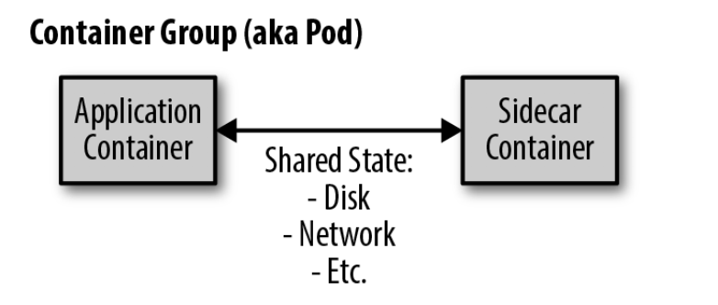
What is sidecar pattern?
Relationship
A sidecar container can be used to add functionality to a container that might otherwise be difficult to improve.
Sidecar containers are coscheduled onto the same machine via an atomic container group, such as the pod API object in Kubernetes.
The application container and sidecar container share a number of resources, including parts of the filesystem, hostname and network

Slide 6
02
Examples

Slide 7
Uses of Sidecar Pattern
proxy traffic into an existing application
configuration synchronization
modularity and reuse of the components used as sidecars
adaptation and monitoring---It can also be used as a means to implement the complete logic for your application in a simplified, modular manner

Slide 8
Example One--- Adding HTTPS to a Legacy Service
Before
Consider, for example, a legacy web service. Years ago, when it was built, internal network security was not as high a priority for the company, and thus, the application only services requests over unencrypted HTTP, not HTTPS. Due to recent security incidents, the company has mandated the use of HTTPS for all company websites . To compound the misery of the team sent to update this particular web service, the source code for this application was built with an old version of the company’s build system, which no longer functions.

Slide 9
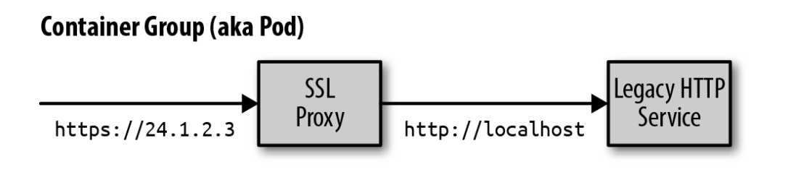
Example One--- Adding HTTPS to a Legacy Service
After
The legacy web service is configured to serve exclusively on localhost (127.0.0.1), which means that only services that share the local network with the server will be able to access the service. Normally, this wouldn’t be a practical choice because it would mean that no one could access the web service. However, using the sidecar pattern, in addition to the legacy container, we will add an nginx sidecar container. This nginx container lives in the same network namespace as the legacy web application, so it can access the service that is running on localhost. At the same time, this nginx service can terminate HTTPS traffic on the external IP address of the pod and proxy that traffic to the legacy web application.

Slide 10
Example Two---DynamicConfiguration with Sidecars
Usage Scenarios
Many applications use a configuration file for parameterizing the application; this may be a raw text file or something more structured like XML, JSON, or YAML. Many pre-existing applications were written to assume that this file was present on the filesystem and read their configuration from there.
However, in a cloud-native environment it is often quite useful to use an API for updating configuration. This allows you to do a dynamic push of configuration information via an API instead of manually logging in to every server and updating the configuration file using imperative commands.
the container that is the serving application
the container that is the configuration manager.
The two containers are grouped together into a pod where they share a directory between themselves. This shared directory is where the configuration file is maintained

Slide 11
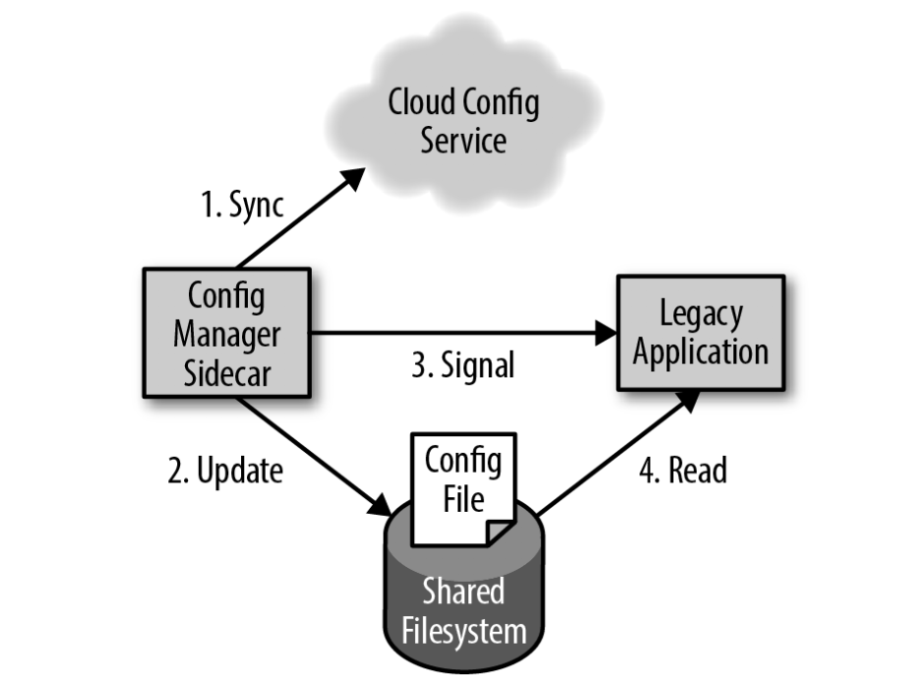
Example Two---DynamicConfiguration with Sidecars

Slide 12
Example Three
Usage Scenarios
Giving a readout of all of the different processes using resources in the container, similar to the top command line tool.
One approach to providing this introspection is to require that each developer implement an HTTP /topz interface that provides a readout of resource usage. To make this easier, you might implement this webhook as a language-specific plugin that the developer could simply link into their application. But even if done this way, the developer would be forced to choose to link it in and your organization would be forced to implement the interface for every language it wants to support. Unless done with extreme rigor, this approach is bound to lead to variations among languages as well as a lack of support for the functionality when using new languages.
Instead, this topz functionality can be deployed as a sidecar container that shares the process-id (PID) namespace with the application container. This topz container can introspect all running processes and provide a consistent user interface. Moreover, you can use the orchestration system to automatically add this container to all applications deployed via the orchestration system to ensure that there is a consistent set of tools available for all applications running in your infrastructure.

Slide 13
Example Four---Building a Simple PaaS with Sidecars
Usage Scenarios
As an example, imagine building a simple platform as a service (PaaS) built around the git workflow. Once you deploy this PaaS, simply pushing new code up to a Git repository results in that code being deployed to the running servers. We’ll see how the sidecar pattern makes building this PaaS remarkably straightforward.
In our simple PaaS application, the main container is a Node.js server that implements a web server. The Node.js server is instrumented so that it automatically reloads the server when new files are updated. This is accomplished with the nodemon tool.
The sidecar container shares a filesystem with the main application container and runs a simple loop that synchronizes the filesystem with an existing Git repository:

Slide 14
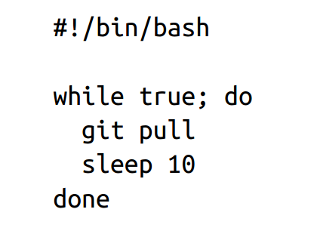
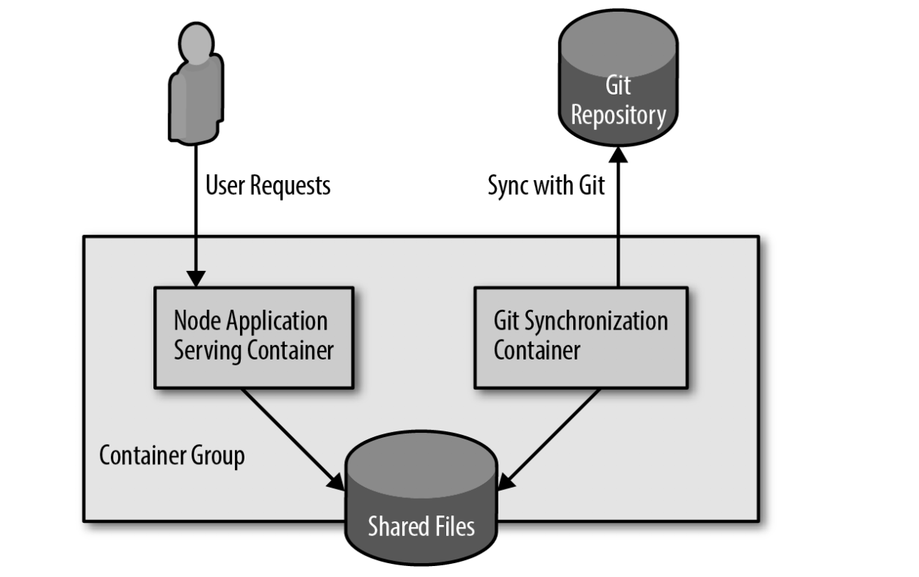
Example Four---Building a Simple PaaS with Sidecars

Slide 15
03
Hands On: Deploying the topz Container

Slide 16
Hands On: Deploying the topz Container
Step One
Deploy some other container to act as the application container:

Slide 17
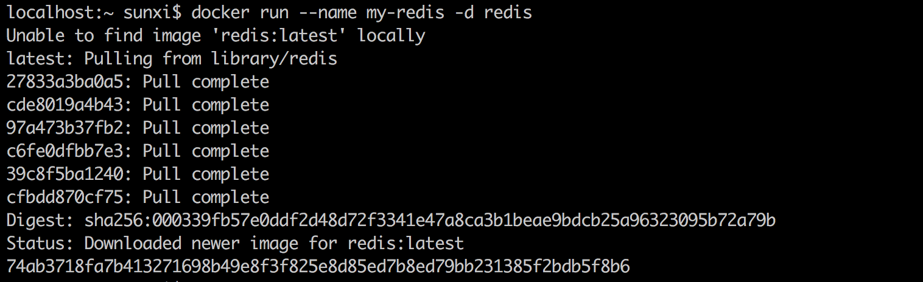
Hands On: Deploying the topz Container
Step One
Deploy some other container to act as the application container:
docker run --name my-redis -d redis
74ab3718fa7b413271698b49e8f3f825e8d85ed7b8ed79bb231385f2bdb5f8b6

Slide 18
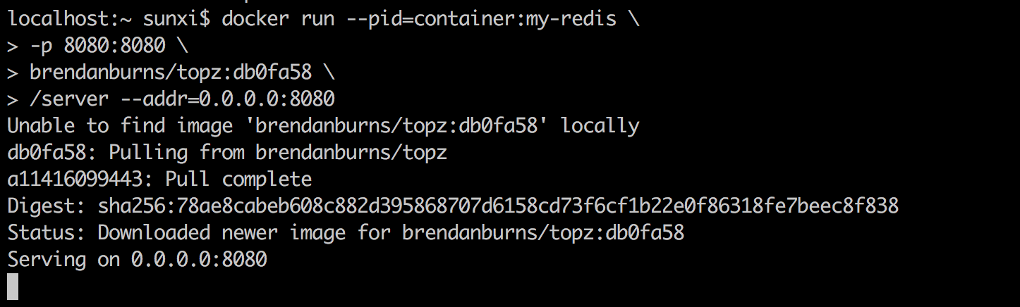
Hands On: Deploying the topz Container
Step Two
docker run --pid=container:my-redis \
-p 8080:8080 \
brendanburns/topz:db0fa58 \
/server --addr=0.0.0.0:8080

Slide 19
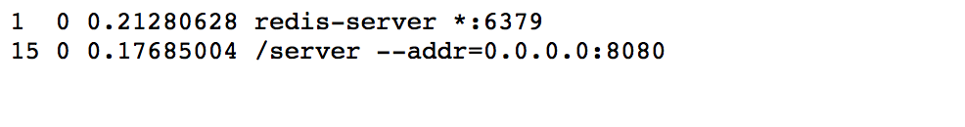
Hands On: Deploying the topz Container
Step Three
http://localhost:8080/topz

Slide 20
04
Designing Sidecars for Modularity and Reusability

Slide 21
Designing Sidecars for Modularity and Reusability
focus on three area
Parameterizing your containers
Creating the API surface of your container
Documenting the operation of your container

Slide 22
Designing Sidecars for Modularity and Reusability
Parameterizing your containers
What do I mean when I say “parameterize”? Consider your container as a function in your program. How many parameters does it have? Each parameter represents an input that can customize a generic container to a specific situation. Consider, for example, the SSL add-on sidecar deployed previously. To be generally useful, it likely needs at least two parameters: the first is the name of the certificate being used to provide SSL, and the other is the port of the “legacy” application server running on localhost. Without these parameters, it is hard to imagine this sidecar container being usable for a broad array of applications.
There are two ways in which such parameters can be passed to your container: through environment variables or the command line.

Slide 23
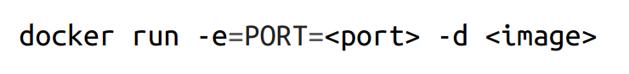
Designing Sidecars for Modularity and Reusability
Parameterizing your containers---Example One
Delivering values into the container is only part of the battle. The other part is actually using these variables inside the container. Typically, to do that, a simple shell script is used that loads the environment variables supplied with the sidecar container and either adjusts the configuration files or parameterizes the underlying application.
Parameterizing your containers---Example Two
You might pass in the certificate path and port as environment variables. In your container, you would use those variables to configure an nginx.conf file that points the web server to the correct file and proxy location.

Slide 24
Designing Sidecars for Modularity and Reusability
Creating the API surface of your container
Given that you are parameterizing your containers, it is obvious that your containers are defining a “function” that is called whenever the container is executed. This function is clearly a part of the API that is defined by your container, but there are other parts to this API as well, including calls that the container will make to other services as well as traditional HTTP or other APIs that the container provides.
As you think about defining modular, reusable containers, it is important to realize that all aspects of how your container interacts with its world are part of the API defined by that reusable container. As in the world of microservices, these microcontainers rely on APIs to ensure that there is a clean separation between the main application container and the sidecar. Additionally the API exists to ensure that all consumers of the sidecar will continue to work correctly as subsequent versions are released. Likewise, having a clean API for a sidecar enables the sidecar developer to move more quickly since they have a clear definition (and hopefully unit tests) for the services they provide as a part of the sidecar.

Slide 25
Designing Sidecars for Modularity and Reusability
Creating the API surface of your container--- configuration management sidecar
A useful configuration for this sidecar might be UPDATE_FREQUENCY, which indicates how often the configuration should be synchronized with the filesystem. It is clear that if, at some later time, the name of the parameter is changed to UPDATE_PERIOD, this change would be a violation of the sidecar’s API and clearly would break it for some users.
Imagine, for example, that UPDATE_FREQUENCY originally took a number in seconds. Over time and with feedback from users, the sidecar developer determined that specifying seconds for large time values (e.g., minutes) was annoying users and changed the parameter to accept strings (10 m, 5 s, etc.). Because old parameter values (e.g., 10, for 10 seconds) won’t parse in this new scheme, this is a breaking API change. Suppose still that the developer anticipated this but made values without units parse to milliseconds where they had previously parsed to seconds. Even this change, despite not leading to an error, is a breaking API change for the sidecar since it will lead to significantly more frequent configuration checks and correspondingly more load on the cloud configuration server.

Slide 26
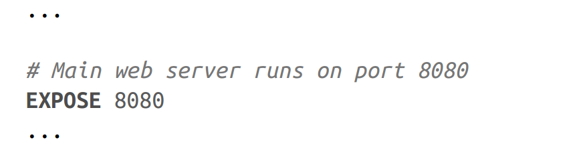
Designing Sidecars for Modularity and Reusability
Documenting the operation of your container
There’s one final step to building modular, reusable containers: ensuring that people can use them in the first place.
For every container image, the most obvious place to look for documentation is the Dockerfile from which the container was built.
EXPOSE directive, which indicates the ports that the image listens on
ENV directive to set default values for those parameters
Use the LABEL directive to add metadata for your image; for example, the maintainer’s email address, web page, and version of the image:

Slide 27
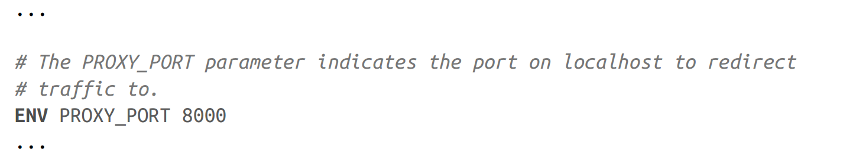
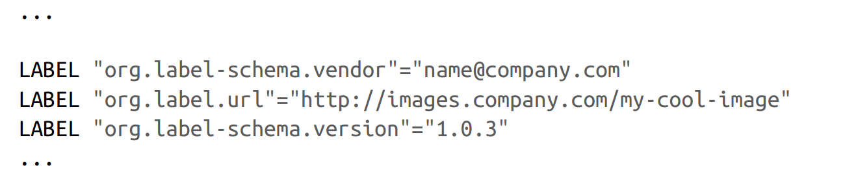
Designing Sidecars for Modularity and Reusability
Documenting the operation of your container
ENV directive to set default values for those parameters
Use the LABEL directive to add metadata for your image; for example, the maintainer’s email address, web page, and version of the image

Slide 28
谢谢！

